Slide 1


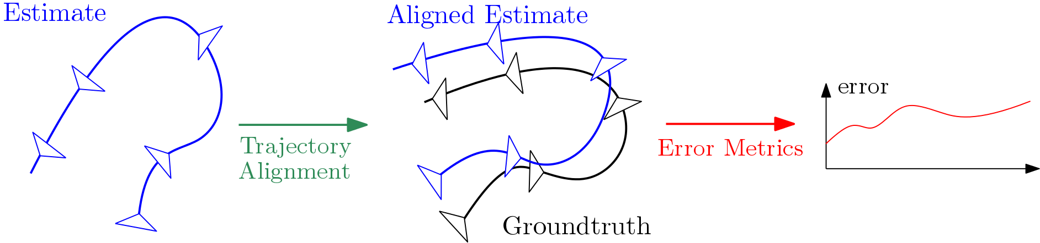
Institute of Informatics – Institute of Neuroinformatics
A Tutorial on Quantitative Trajectory Evaluation
for Visual(-inertial) Odometry
Zichao Zhang, Davide Scaramuzza

Slide 2
Why is trajectory evaluation tricky?
Key difficulty: Unobservable degrees of freedom (scale, global position…)
Measurements
Equivalent Estimates
How can we get the same estimation error from all the equivalent estimates?
Groundtruth
…
e₃
Trajectory Alignment
…
e₁
e₂
De facto standard: first find the equivalent estimate that is closest to the groundtruth and then compute the error metrics.
Zichao Zhang - University of Zurich – A Tutorial on Quantitative Trajectory Evaluation for Visual(-inertial) Odometry

Slide 3
Trajectory Alignment: Visual-Inertial Setup
Equivalence: The alignment must not change the predicted measurements!
→ The type of transformation depends on the specific sensing modality.
Configuration | Monocular | Stereo | Inertial (+visual)
Type of Alignment Transformation | Similarity (7 DoF) | Rigid body (6 DoF) | Translation + Rotation around gravity (4 DoF)
gravity
Estimate
Groundtruth
Zichao Zhang - University of Zurich – A Tutorial on Quantitative Trajectory Evaluation for Visual(-inertial) Odometry

Slide 4
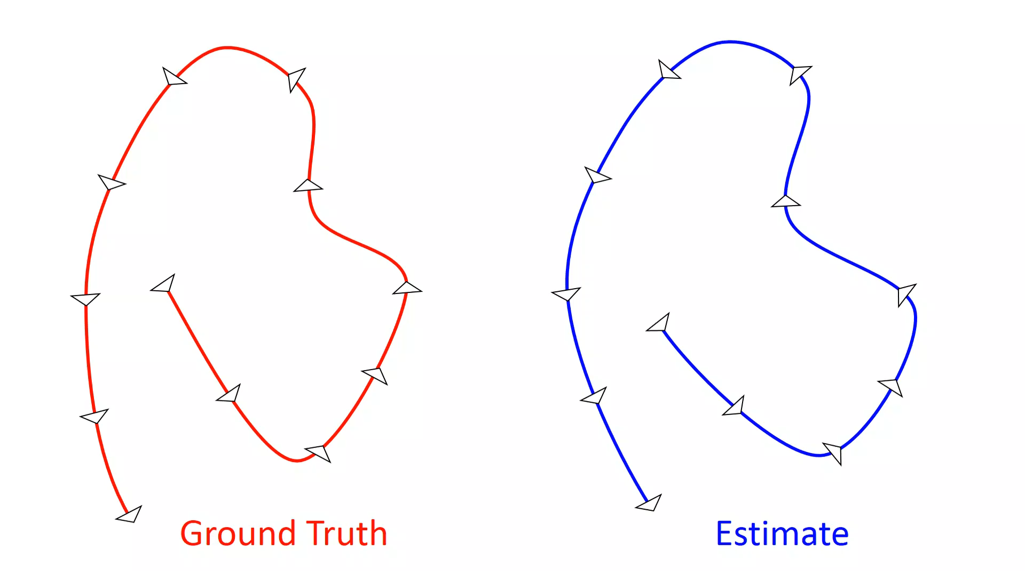
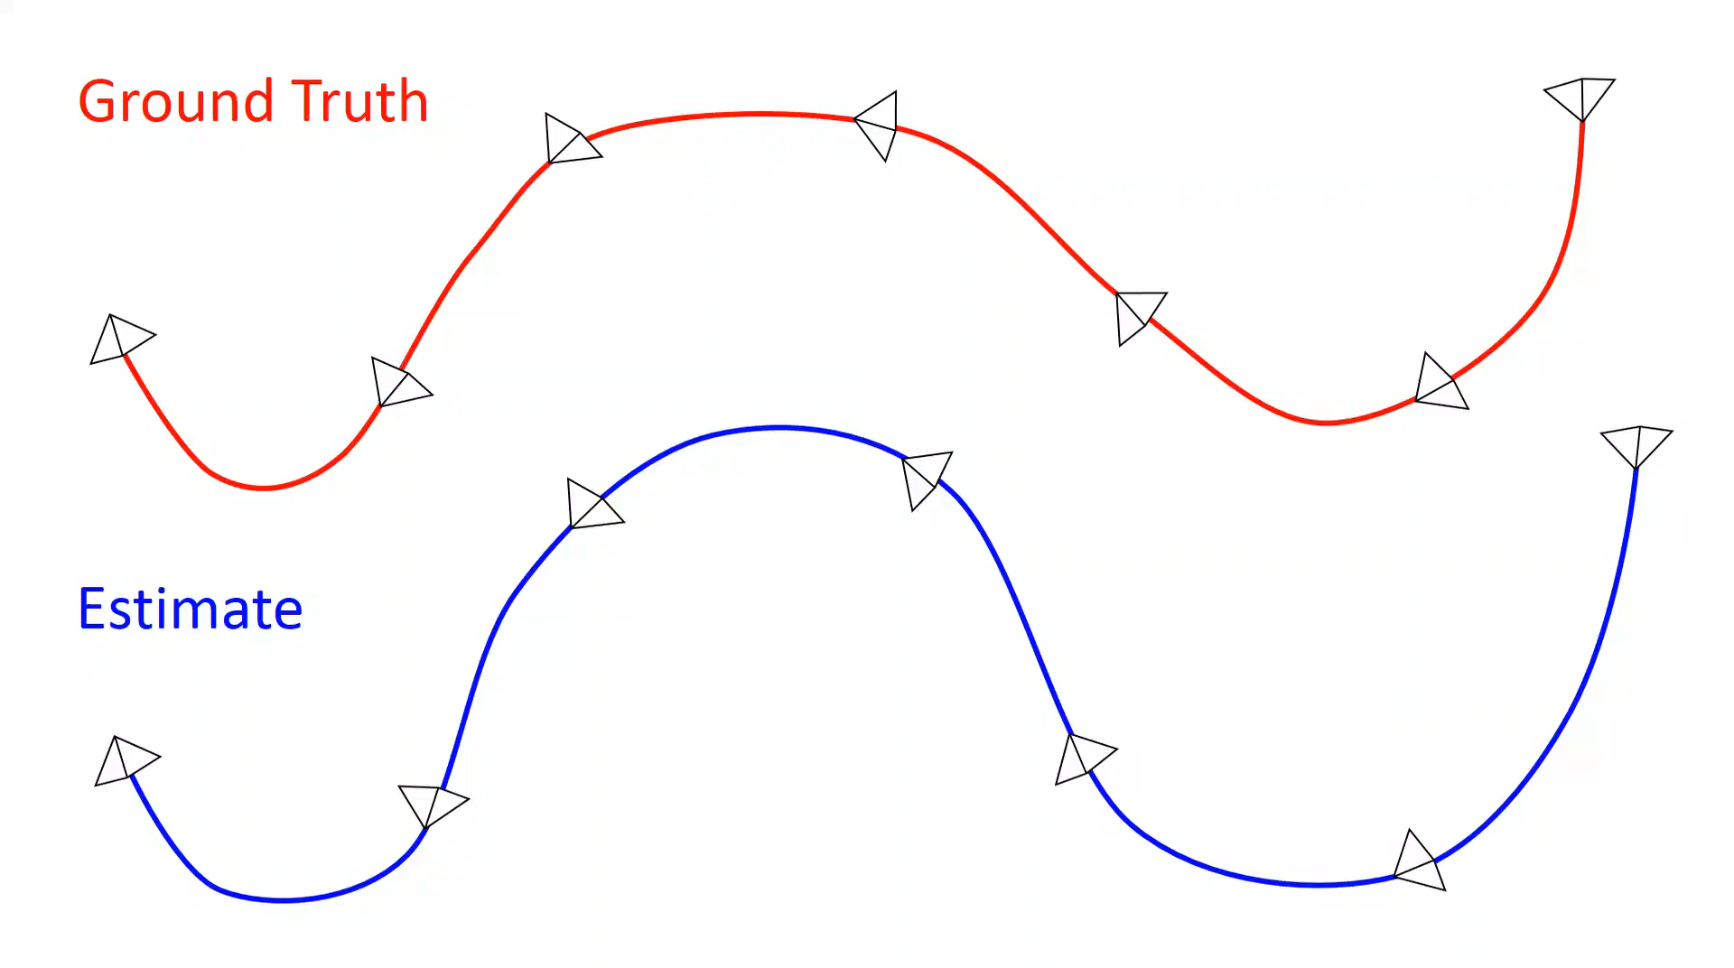
Error Metrics: Absolute and Relative Error
Absolute Trajectory Error
RMSE of the aligned estimate and the groundtruth.
Relative Error (Odometry Error)
Statistics of sub-trajectories of specified lengths.
✓ Single number metric
✗ Sensitive to when the estimation
error occurs
✓ Informative statistics
✗ Complicated to compute and rank
Zichao Zhang - University of Zurich – A Tutorial on Quantitative Trajectory Evaluation for Visual(-inertial) Odometry

Slide 5

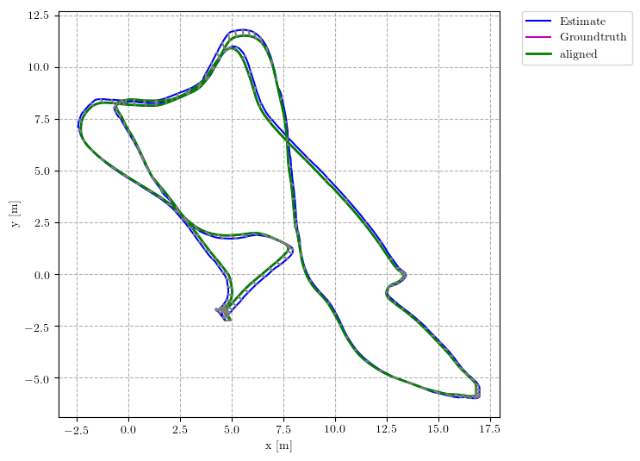
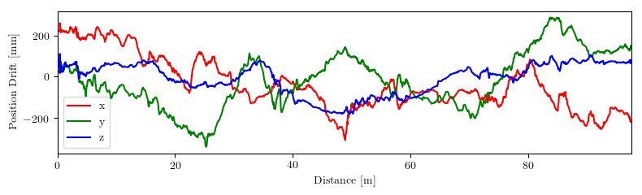
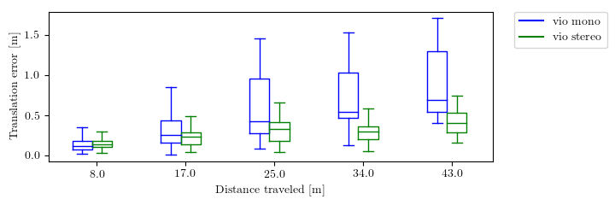
Trajectory Evaluation Toolbox
Available at
https://github.com/uzh-rpg/rpg_trajectory_evaluation
The toolbox provides:
Concise interface: one line command to run all evaluations
Easily compare multiple algorithms on multiple datasets
(Nearly) paper ready plots and tables
Easy customization
Visit me at booth 3 for more details!
Zichao Zhang - University of Zurich – A Tutorial on Quantitative Trajectory Evaluation for Visual(-inertial) Odometry
Notes:
Since quantitative trajectory evaluation is a complicated task involving many details, we release an open source trajectory evaluation toolbox.
It implements different trajectory alignment methods and error metrics mentioned in this work.
It is designed for easy use and customization. It has a clearly defined interface so that the results can be easily exchanged and reproduced using the toolbox.
For more details, please visit me at booth 3, thanks,
25

